Slide 1

Computer Engineering Department
A.P. Shah Institute of Technology
G.B.Road,Kasarvadavali, Thane(W), Mumbai-400615 UNIVERSITY OF MUMBAI
Academic Year 2022-2023

Slide 2
A Project Report on
DISEASE PREDICTION (GROUP NO.2)
Submitted in partial fulfillment of the degree of
Bachelor of Engineering(Sem-VI)
in
Computer Engineering
By
•Student name: Yash Jayant Kanade Roll no:75 Division: B
•Student name: Vansh Virendra Jain Roll no:70 Division: B
•Student name: Vansh Jeetendra Jain Roll no:69 Division: B
•Student name: Ghanshyam Jignesh Kachhia Roll no:72 Division: B
Under the Guidance of
PROF. S.B.TAKMARE

Slide 3
PROBLEM STATEMENT
Many of the machine learning models now in use for healthcare analysis focus on just one disease at a time.
A person must visit various websites if he or she wants to predict more than one sickness. A single analysis cannot forecast more than one disease using a same system.
Some of the models have poorer accuracy, which has a major impact on the health of the patients. When a company wants to analyse the health reports of its patients, they must use numerous models, which raises the cost and effort involved. Several of the existing systems take into account only a few parameters, which can lead to inaccurate findings.

Slide 4
OBJECTIVES
Develop an accurate machine learning model for predicting multiple diseases from patient medical data.
Validate the machine learning model's accuracy with a test dataset.
Identify potential correlations between multiple diseases from medical data.

Slide 5
SCOPE
In the future, disease prediction could be improved by developing machine learning models that use a combination of data sources such as genetic, environmental, and lifestyle data.
These models could be used to identify individuals at higher risk of certain diseases, allowing for earlier and more effective interventions.
Additionally, advances in artificial intelligence, natural language processing, and image recognition could enable more accurate diagnoses, leading to earlier and more accurate disease predictions.
Finally, the use of big data in disease prediction could lead to improved accuracy and better understanding of disease risk factors.

Slide 6
TECHNOLOGY STACK
Python
Flask
Html,Css
Jupyter Notebook

Slide 7
Flow Of Modules
Collected,Analysis & Preprocessing Data for diabetes ,heart attack and Kidney Disease prediction model.
Trained the datasets using different algorithms like RandomForest,Logistic Regression,XgBoost and KNN.
By choosing algorithm with best accuracy ,we developed a model.
Created front end in Html and Css and connected using Flask

Slide 8
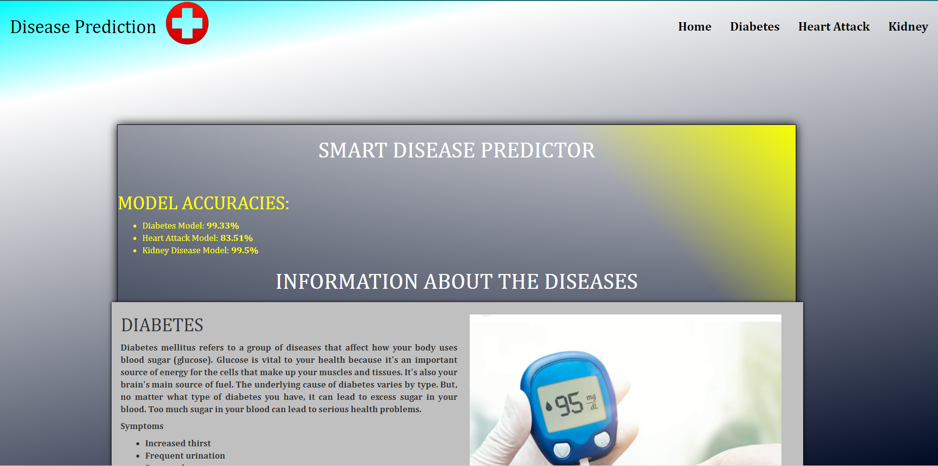
Result

Slide 9
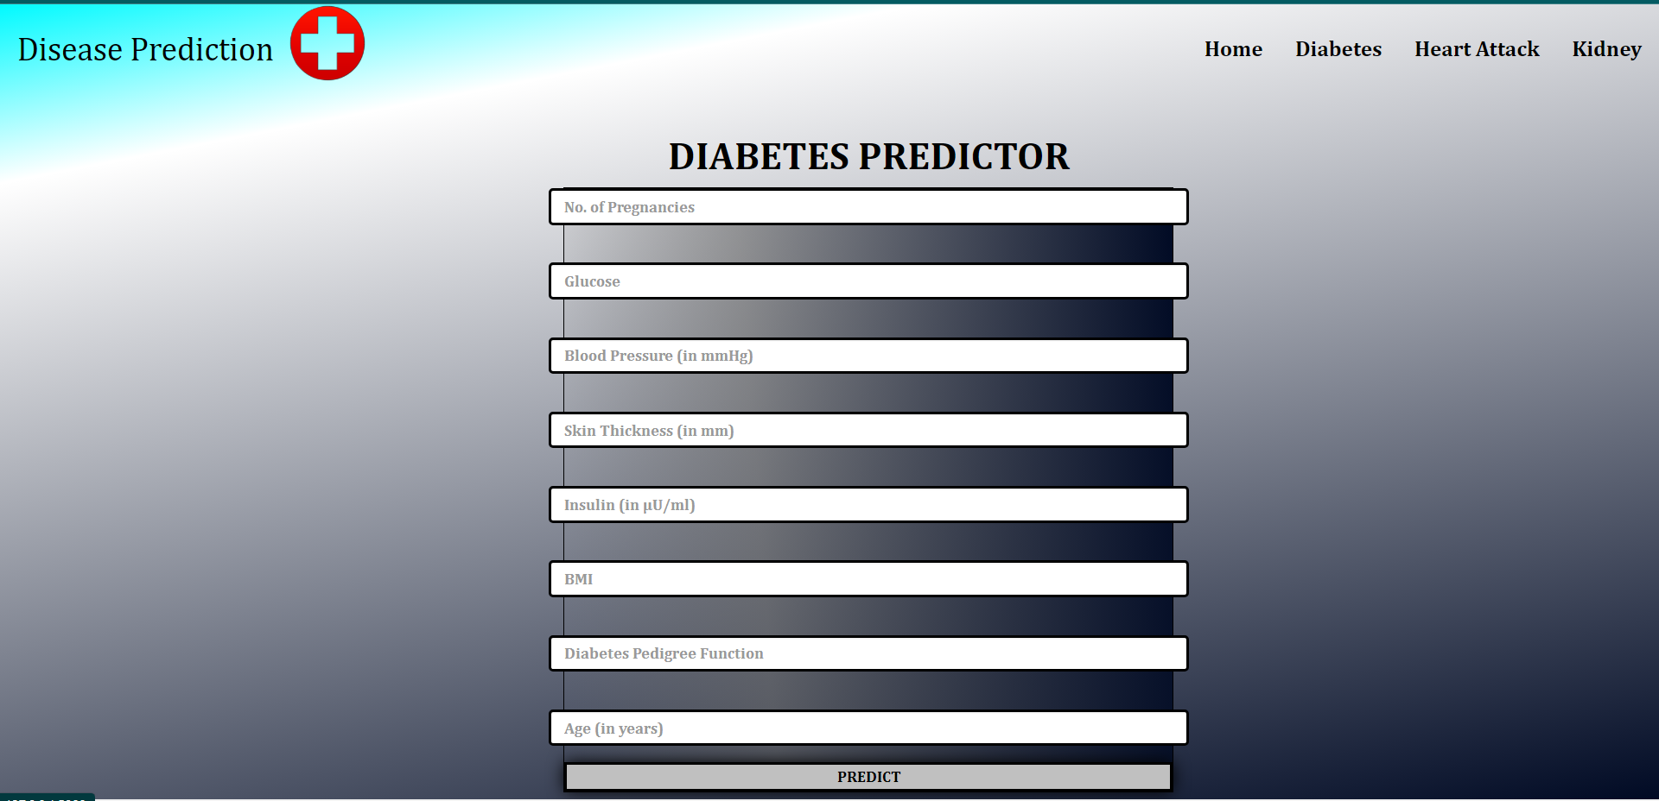

Slide 10
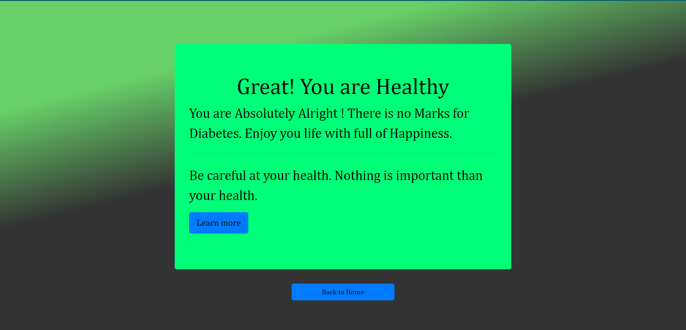

Slide 11
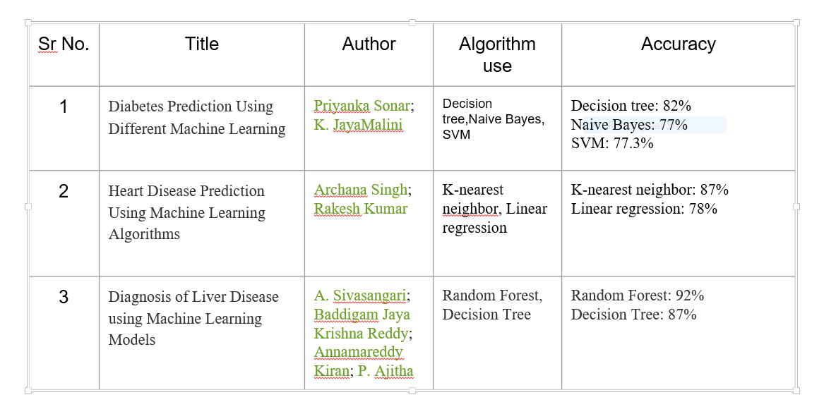
REFERENCES

Slide 12
THANK YOU

